Slide 1

US Crime prediction using LightGBM classifier

Slide 2


Group members
Nikhil Jolapuram - 700739534
Mogalapu Gideon Jaideep Sudarshan - 700740439
Adumala Yashwanth Reddy – 700739651
Mankala Pranay Reddy – 700742423

Slide 3
Roles and contribution in project
The Requirement analysis and some of the Data collection and cleaning is done by Jaideep
Project flow design , Data exploration-EDA and some of the ML model implementation is done by Yashwanth
Setting the deadlines, Data exploration-EDA and ML model implementation is done by Pranay
Data collection and cleaning and Hyper parameter tuning is done by Nikhil

Slide 4

MOTIVATION
Crime prevention: By predicting where and when crimes are likely to occur, law enforcement agencies can take proactive measures to prevent crime from happening.
Improved public safety: Accurate crime prediction can help law enforcement agencies respond more effectively to incidents, reducing the risk of harm to the public.
Better resource allocation: Predictive models can help law enforcement agencies prioritize their resources, such as patrol routes and investigative efforts, to areas where crime is more likely to occur.

Slide 5

OBJECTIVES
The project's objective is to anticipate a crime using several machine learning techniques and select the model that performs the best given the available data.
The San Francisco crime dataset, which is freely accessible on the Kaggle platform, is used to carry out the study.
We have a number of parameters in the dataset, including latitude, longitude, the date the incident occurred, and the type of crime.
Several machine learning techniques are used on this data to categorize crimes and places.

Slide 6
Related work
Machine learning helps to find the patterns in the data. One important application in finding the patterns is predicting the crimes in vulnerable areas. There are so many applications available to protect the people from the crimes and potential crimes.
The main objective of this project is to predict the crimes in a given place whether they happen or not. These predictions need to be given for specific inputs like location, neighbour- hood, date time. Crime prediction is a challenging problem due to the high dimensions of the data and high number of crime categories in some areas.
The existing algorithms provide the type of crime oc- currence. Using kaggle San Francisco crime data we have conducted the experimental analysis. Existing algorithms like classification algorithms classify the types of crimes in the particular location. Knowing only the crime type does not help the common people. Knowing the time of occurrence helps the authorities to prevent the crimes. In this paper we are proposing Naive Bayes classifier to classify the crime incident at a particular time of the day

Slide 7
Related work
Crime analysis is the most important type of prediction. In this paper we are proposing a machine learning algorithm to find the hotspots of the crimes. After finding hotspots we embed the locations onto the geo spatial locations. This information helps the authorities to track the crime incident. we are proposing a Random Forest algorithm to detect the future crimes.
In this paper we are proposing a LSTM model to predict the crime type in a particular location. In total we have implemented the 3 types of algorithms LSTM , Improved single community prediction LSTM1 and multi community prediction LSTM3. Extensive experiments are conducted on the Chicago crime dataset. we are considering the hotel reviews to predict the crimes. The assumptions show that hotel reviews are inversely proportional to the positive reviews and vice versa.
In addition to Support Vector Machine , K-means clustering is also applied and these algorithms achieved 65 percent accuracy. This accuracy is not satisfactory so future enhancements are required to predict the future samples.

Slide 8

PROBLEM STATEMENT
Looking at the crime rates of several decades between 1900 and 1970, the graph was at its pinnacle, and in the year 1990, the graph started to plummet.
This trend persisted until the year 1992. Despite the fact that crime is on the decline throughout the years, violent crime is on the rise.
This tells the tale of the United States, although the pattern varies around the globe. It is challenging to foresee recurrent crimes in a given area.
To lower the crime rate and stop crime before it occurs, crime forecasting is crucial for each particular place.

Slide 9
PROPOSED SOLUTIONS
In this project we have implemented a variant of the gradient boosting algorithm with tree based learning algorithms as base learners. Main features of this algorithm are:
● Light in LightGBM denotes high speed during training
● This is majorly used in large datasets since it consumes less memory.
● LightGBM supports the GPU training
● This can not be used on smaller datasets because it overfits data
● LightGBM classifier speed is 1.5-3 times the speed of XGBoost algorithm.
● Key difference in LightGBMC and other gradient boosting algorithm XGBoost is: XGBoost splits the tree nodes one level at a time whereas this algorithm splits the one node at a time.

Slide 10
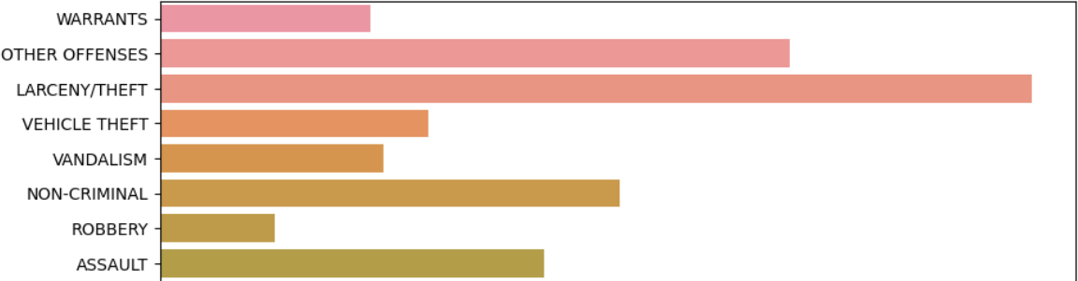
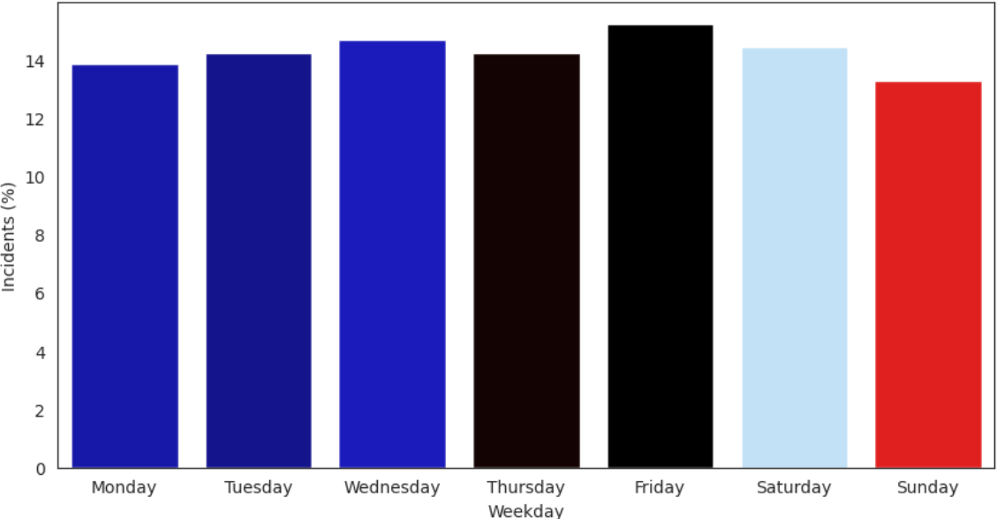
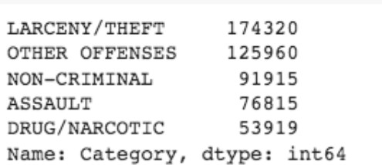
Results
To conduct the experimental analysis we have used the benchmark dataset San Francisco crime dataset. To reduce the computational power and training time we have sliced the dataset into top 5 crimes in the city theft, other offenses, on- criminal, assault and drug or narcotic. After slicing the dataset we have split the dataset into training and testing. LightGBM classifier is trained with the training samples after the training process unseen or test samples are predicted.

Slide 11
References
N Kanimozhi, N V Keerthana, G S Pavithra, G Ranjitha, and S Yuvarani. Crime type and occurrence prediction using machine learning algorithm. In 2021 International Conference on Artificial Intelligence and Smart Systems (ICAIS), pages 266–273, 2021.
K. Chitra Lekha and S. Prakasam. Data mining techniques in detecting and predicting cyber crimes in banking sector. In 2017 International Conference on Energy, Communication, Data Analytics and Soft Com- puting (ICECDS), pages 1639–1643, 2017.
Darshan M S and Shankaraiah Shankaraiah. Crime analysis and prediction using machine learning algorithms. In 2022 IEEE 2nd Mysore Sub Section International Conference (MysuruCon), pages 1–7, 2022.
Nurul Hazwani Mohd Shamsuddin, Nor Azizah Ali, and Razana Alwee. An overview on crime prediction methods. In 2017 6th ICT International Student Project Conference (ICT-ISPC), pages 1–5, 2017.

